Slide 1
RULE OF CHALLENGE
EXECUTE IN PAPER TO FIND OUTPUT.
TEAM COME FIRST GET 2 POINT IF ANSWER IS CORRECT
TEAM COME LATER WILL GET 1 POINT IF ANSWER IS CORRECT
IF NOT GET 0
EACH EXERCISES WE HAVE LIMITED TIME.
IF TEAM COME LATER THAN TIME LIMITED WITH GET 0

Slide 2
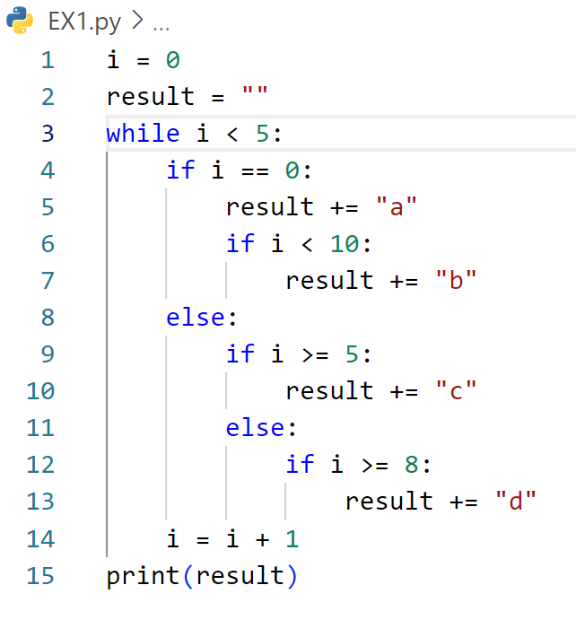
Define the output of code below

Slide 3
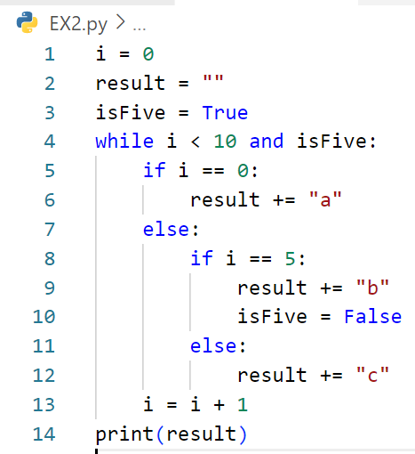
Define the output of code below

Slide 4
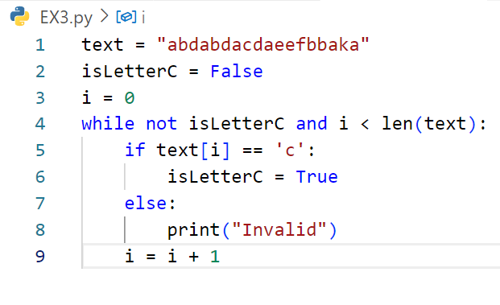
Define the output of code below

Slide 5
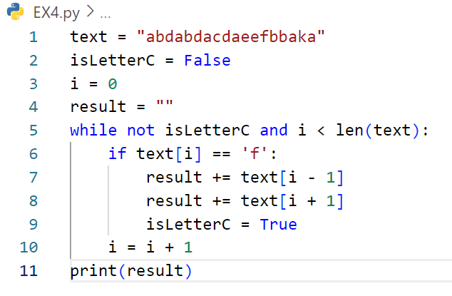
Define the output of code below

Slide 6
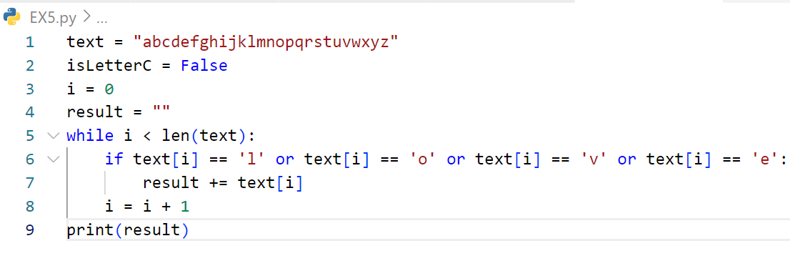
Define the output of code below

Slide 7
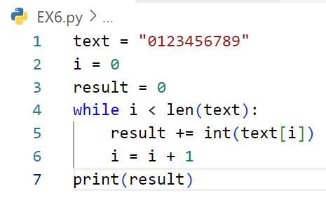
Define the output of code below

Slide 8
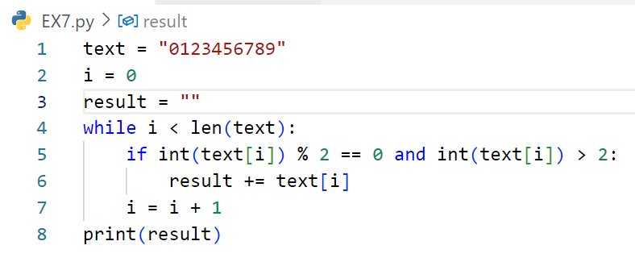
Define the output of code below

Slide 9
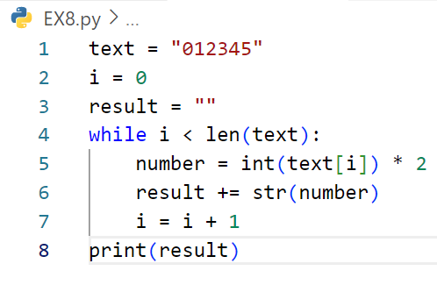
Define the output of code below

Slide 10
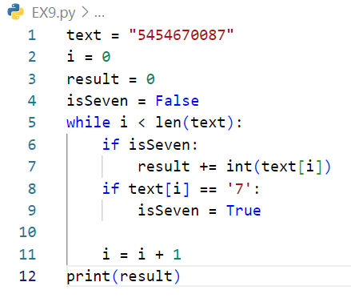
Define the output of code below

Slide 11
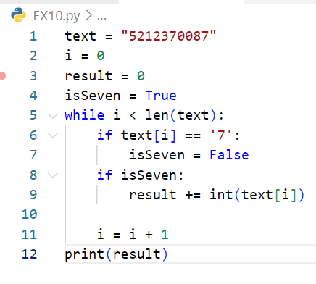
Define the output of code below

